Slide 2
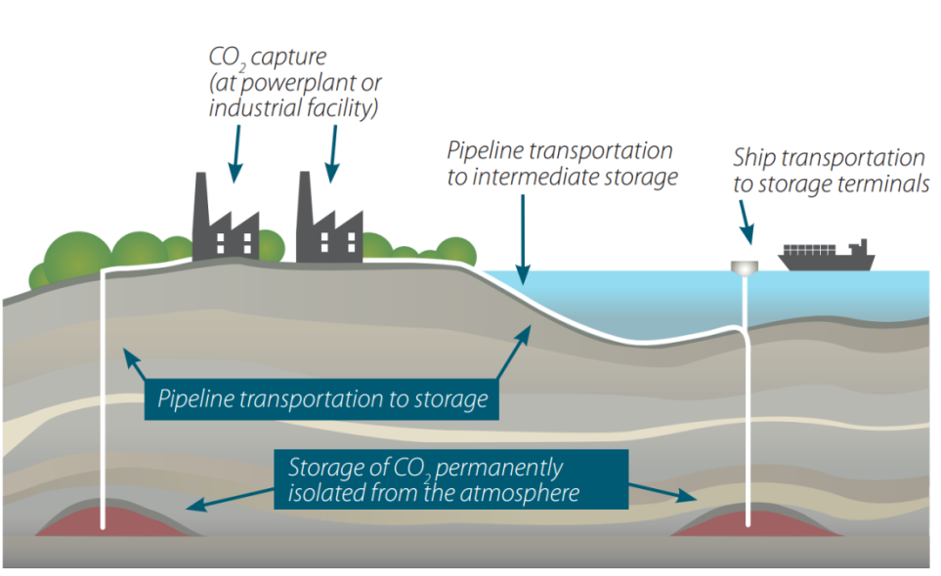
Carbon Capture and Storage Program (CCSP)
Target: technological readiness for pilots and demonstrations by the end of the program
17 industrial partners, 9 research partners, 1.1.2011 – 31.10.2016
Volume: 15 M€
Key focus areas:
Carbon capture and storage (CCS) in CHP systems
CCS related to multi-fuel and Bio-CCS
Solid looping technologies (e.g. CLC)
Overcoming non-technical barriers for CCS
Monitoring technologies
Mineral carbonation
Close collaboration with IEA GHG, NORDICCS, Swedish CCS Project (Bastor2), Bastor, BASREC
Participation in IEA GHG, IEA CCS, ZEP, EERA CCS, ENeRG, CGS Europe, International Gas Union

Slide 3
Thank you for your attention!
[Add task/subtask partner logos here]
http://clicinnovation.fi/activity/ccsp

