Slide 1
D2.3.9 State of the art in commissioning tests
Pertti Pakonen, Ossi Bergius, 8 February, 2012

Slide 2
Commissioning tests
Cables and accessories – what kind of defects should be tried to exclude with commissioning tests?
Commissioning test methods
  Insulation resistance test
  Sheath integrity test
  High voltage test
  Partial discharge measurement
  Dielectric loss measurement (Tan δ), dielectric spectroscopy

Slide 3
Commissioning tests worldwide
Pertti Pakonen, Ossi Bergius / TUT, Department of Electrical Energy Engineering

Slide 4
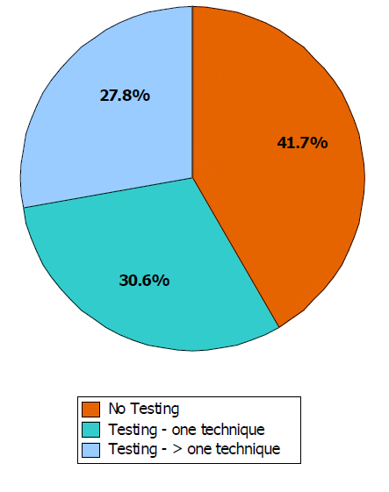
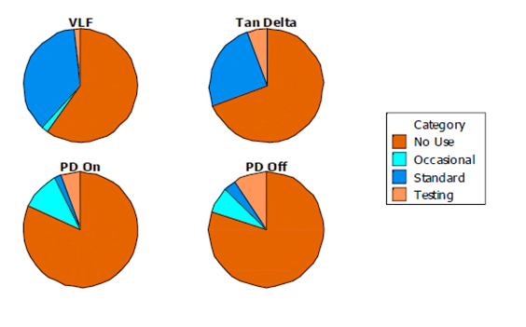
The use of diagnostic measurements in USA
The use of diagnostic measurements for medium voltage cables in North America between 2006-2008
Hartlein, R.; Hampton, N.; Perkel, J.; Altamirano, J.; Andrews, T.; del Valle, Y.; Parker, T. J.; Begovic, M.; Hernandez-Mejia, J. C.;
“Diagnostic Testing of Underground Cable Systems”, http://www.neetrac.gatech.edu/publications/ CDFI_Phase_1_Final-Report.pdf
Pertti Pakonen, Ossi Bergius / TUT, Department of Electrical Energy Engineering

Slide 5
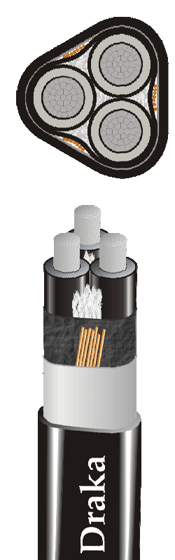
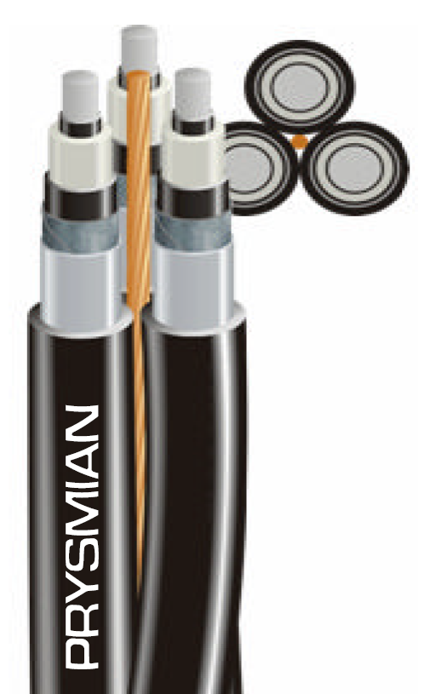
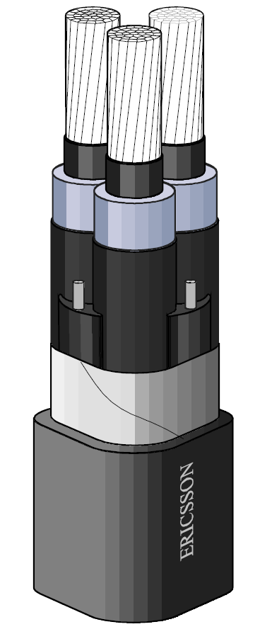
Polymeric medium voltage cable types that are used in Finland
The factory test for cables includes: partial discharge measurement which is done to ensure the faultlessness of the main insulation and spark test which ensures the outer sheath integrity
It is still possible that the outer sheath is damaged during the transportation, storing or installation
Mechanical stresses might damage also the main insulation and semi-conductive layers
AHXAMK-W
AXLJ-TT
AXAL-TT
Pertti Pakonen, Ossi Bergius / TUT, Department of Electrical Energy Engineering

Slide 6
Cable joints and terminations
Joints and terminations are the most common reason behind cable faults if faults caused by third parties are not counted
Both are handmade at the installation site sometimes in bad environmental conditions
The quality assurance of the installation work is inadequate (at the moment only visual inspection, insulation resistance test and sheath integrity test)
Cable failure causes in 11 kV XLPE
cable network in Macau
Pertti Pakonen, Ossi Bergius / TUT, Department of Electrical Energy Engineering

Slide 7
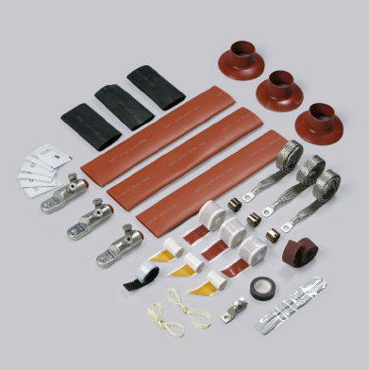
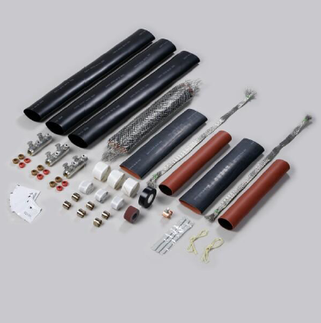
Cable joints and terminations
AHXAMK-W cable termination package (3 phases)
AHXAMK-W cable joint package (3 phases)
Pertti Pakonen, Ossi Bergius / TUT, Department of Electrical Energy Engineering

Slide 8
Insulation resistance test
Insulation resistance test is used to test the live parts have sufficient insulation from the earth. It reveals mainly:
    Severe installation errors
    Possibly attached (work) earthings
  Generally used in Finland and elsewhere
  In medium voltage level the test is usually done with 2,5…5 kV DC voltage between each phase and earth and between phases if required
  The result is insulation resistance reading or readings as a function of time (or voltage)
Pertti Pakonen, Ossi Bergius / TUT, Department of Electrical Energy Engineering

Slide 9
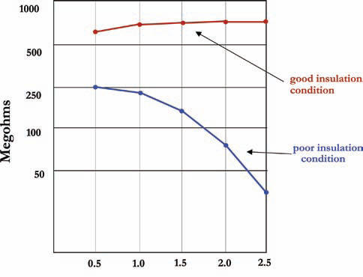
Diagnostics
Insulation resistance test can also offer information about the condition of the insulation (humidity, dirtiness)
  Trends as a function of time and voltage
  Examination period can be a few minutes or annual measurements
Insulation resistance is temperature dependent
  Rule of thumb: 10 ºC rise in temperature halves the resistance value (temperature correction of the results is important)
Voltage (kV)
Pertti Pakonen, Ossi Bergius / TUT, Department of Electrical Energy Engineering

Slide 10
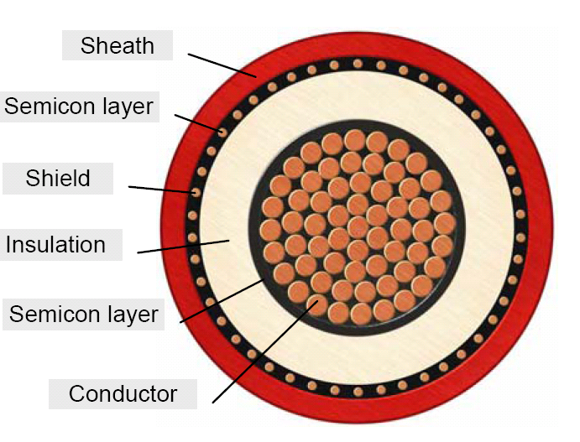
Cable sheath integrity
Moisture can penetrate into a cable from a defect in cable sheath. The result can be
    In polymeric cables formation of water trees in the main insulation
      Dielectric breakdown of the main insulation
    Moisture migration to a joint (especially when the cable doesn’t have longitudinal moisture protection)
      Dielectric breakdown of the joint
It can take months or years before a cable sheath defect leads to a cable failure
If the sheath defect is caused for example due to a hit or pressed by a rock, the cable shield might penetrate through the cable insulation shield into the main insulation
  => The electric field distortion formed this way can cause partial discharges, which in process of time will lead to a breakdown
Pertti Pakonen, Ossi Bergius / TUT, Department of Electrical Energy Engineering

Slide 11
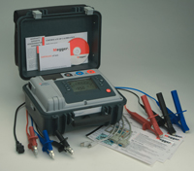
Sheath integrity test
Sheath integrity test is used to check that the outer sheath of a cable is unharmed
For instance LNI Network Inc. requires that sheath integrity test is performed as a part of the cable commissioning
Must be taken into account when cable joints are installed. The construction of a cable joint has to be such that earth leakage is avoided
The measurement can be done with insulation resistance meter
The requirement can be for example: With 5 kV DC voltage the cable sheaths insulation resistance must be at least 500 MΩ/km (Leakage current under 10 μA/km)
If the requirement is not met the defect must be located and repaired
  Requires special measurement equipment (rough location for example with a bridge measurement, precise location with pulsed DC voltage source and earth electrodes + electrometer)
Pertti Pakonen, Ossi Bergius / TUT, Department of Electrical Energy Engineering

Slide 12
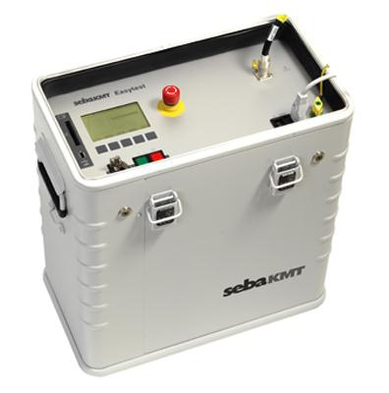
High voltage test
The capacitance can be very high in case of long cables and thus powering up these cables at 50 Hz frequency with transferrable equipment is problematic
In VLF (very low frequency)-method the frequency of the test voltage is usually below 1 Hz. Thus it is possible to make reasonable size equipment
  On the other hand, for example the results of a partial discharge test are not directly comparable with 50 Hz measurements
VLF-test can be made as
  Withstand test (U = 2,0…3,0 ∙U₀, t = 15…60 min)
    Destructive test, big electrical trees and severe mechanical defects will lead to a breakdown
  Diagnostic test (PD and Tan δ are measured at the same time)
    Non-destructive test, reveals even the smallest defects which won’t lead in to a breakdown in short time but might do so over weeks, months or years
Pertti Pakonen, Ossi Bergius / TUT, Department of Electrical Energy Engineering

Slide 13
High voltage test
European standard for Cable After Laying Test CENELEC HD 620 S1 and HD 621 S1
The growth rate of an electrical tree
  50 Hz frequency: 1,7 mm/h
  0,1 Hz frequency cosine square wave: 7,8 mm/h
  0,1 Hz frequency sine wave: 12,3 mm/h
VLF-testing is used to some extent in Central Europe, but not yet in Finland
HV Test for PE or XLPE cables from 6 to 36 kV
Method | Frequency | Test Voltage (rms) | Test time
VLF | 0,1 Hz | 3 x U0 | 60 min
Power frequency | 50 Hz | 2 x U0 | 60 min
Pertti Pakonen, Ossi Bergius / TUT, Department of Electrical Energy Engineering

Slide 14
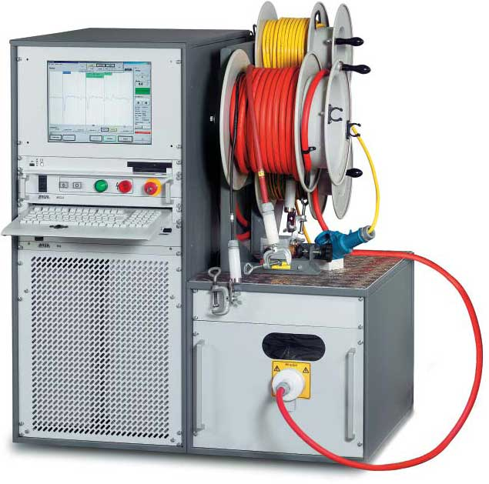
High voltage test pros and cons
Requires simple and relatively inexpensive equipment
Uses very simple procedures
Does not require a trained analyst to interpret results
Does not monitor the effect of the test on the cable during the voltage application
Relies on ‘pass or fail’, thus exposing it to the ‘destructive test’ label
Weakens all defects simultaneously, but fails only one at a time
Can initiate test/fail/repair/test cycles which can be costly and onerous
Lanz B., Cable Testing Options Compared, IMCORP, 2004
Pertti Pakonen, Ossi Bergius / TUT, Department of Electrical Energy Engineering

Slide 15
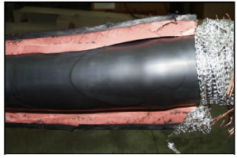
Partial discharge measurement
For example voids, cracks, contaminants, protrusions and deficient electric stress control in insulation structure cause partial discharges
Partial discharges accelerate the aging of the insulation and often lead in to a breakdown (time to a breakdown can be very short)
Partial discharge measurement is suitable for
  Quality assurance before commissioning
  Condition monitoring during cable operation
For the time being not used in Finland as quality assurance method, also elsewhere rarely used for medium voltage cables
Measurement method can be divided to
  Off-line measurements
  Periodic on-line measurements
  Continuous on-line measurements
A void between the stress control
Layer of a termination and the
Outer insulation layer
Pertti Pakonen, Ossi Bergius / TUT, Department of Electrical Energy Engineering

Slide 16
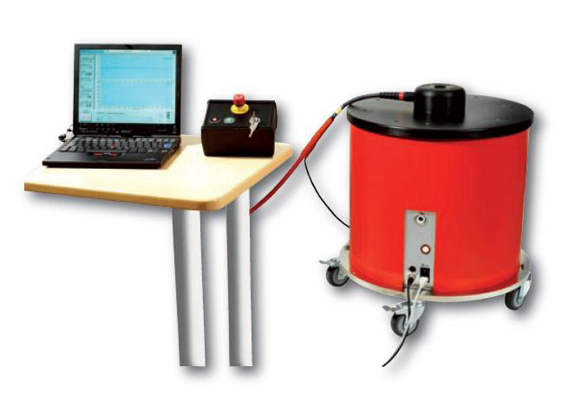
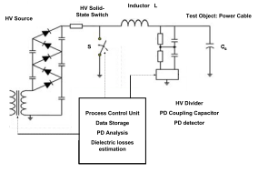
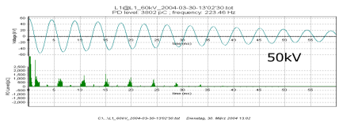
Off-line PD measurement
Test voltage either with VLF equipment or resonance circuit (OWTS)
Oscillating wave test system (OWTS)
  Makes possible to define the magnitude of the partial discharges and the extinction voltage
  Enables defect location
  Enables the measurement of the cable capacitance and the dielectric loss
OWTS
Voltage
PD
Pertti Pakonen, Ossi Bergius / TUT, Department of Electrical Energy Engineering

Slide 17
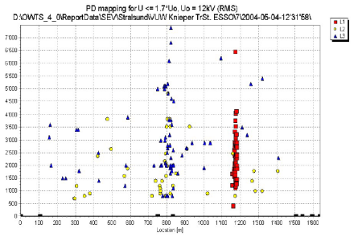
OWTS
The equipment locates the source of the measured partial discharges
The defected site is found from the spot where most of the partial discharges are concentrated
Discharge
pulse magnitude
Distance [m]
Pertti Pakonen, Ossi Bergius / TUT, Department of Electrical Energy Engineering

Slide 18
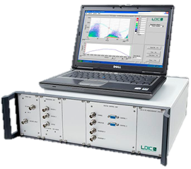
PD measurement pros and cons
Is a non-destructive test
Is the only testing method which can detect and locate high impedance defects such as voids, cuts electrical trees and tracking
Is effective at locating defects in mixed dielectric systems
Is limited to cables with a continuous neutral shield
Requires a trained analyst to interpret measurements
Cannot detect and locate conduction type defects
Becomes complex, onerous and loses accuracy in branched network applications
Lanz B., Cable Testing Options Compared, IMCORP, 2004
Pertti Pakonen, Ossi Bergius / TUT, Department of Electrical Energy Engineering

Slide 19
Characteristics of commissioning tests
Lanz B., Cable Testing Options Compared, IMCORP, 2004
Pertti Pakonen, Ossi Bergius / TUT, Department of Electrical Energy Engineering

Slide 20
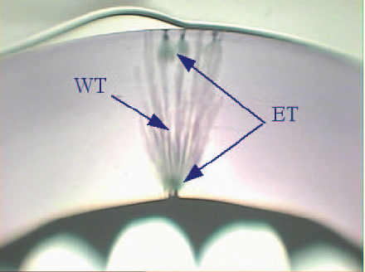
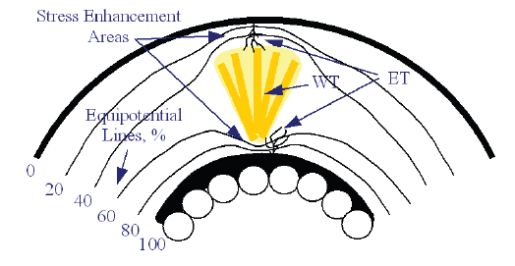
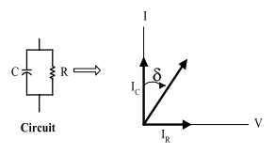
Dielectric loss measurement (Tan δ)
Dielectric loss measurement can detect e.g. moisture (water trees) and contaminants in cable insulation
Dielectric loss measurement describes the condition of the whole system (it doesn’t locate possible defects)
The measurement is done off-line e.g.
  With OWTS-equipment at the same time with off-line partial discharge measurement
  With separate dielectric loss measurement equipment
Pertti Pakonen, Ossi Bergius / TUT, Department of Electrical Energy Engineering

Slide 21
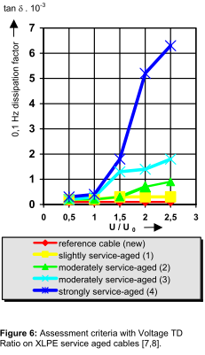
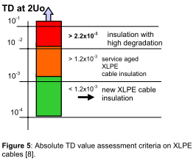
Diagnostics
Dissipation factor for a new XLPE-cable at measurement voltage 2 x U₀ should be tanδ < 1.2 x10⁻³
Dissipation factor increases when cable is aging and/or the moisture content is increasing
Pertti Pakonen, Ossi Bergius / TUT, Department of Electrical Energy Engineering

Slide 22
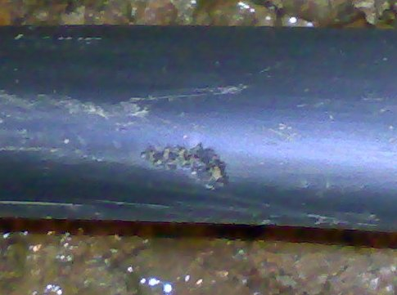
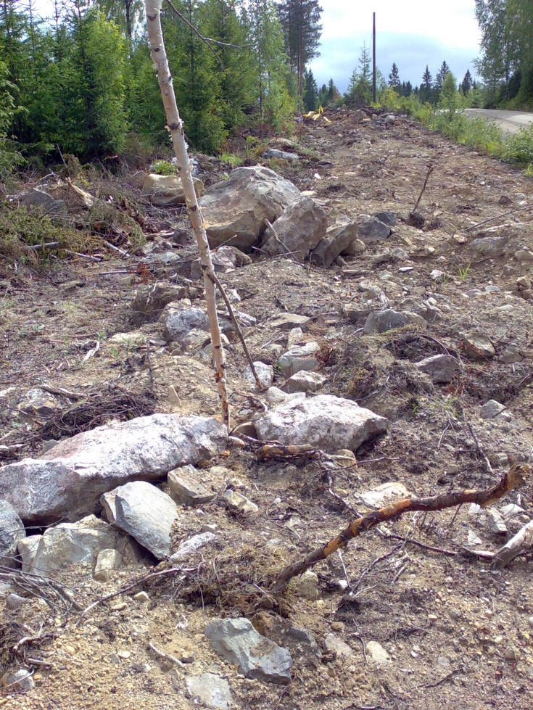
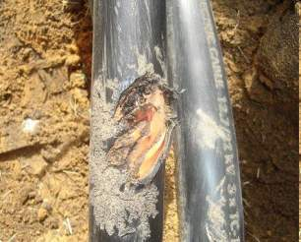
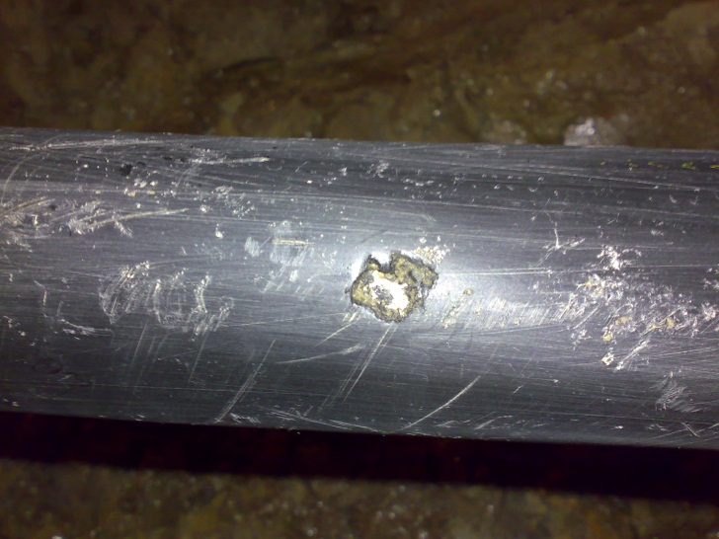
Sheath defects
Pertti Pakonen, Ossi Bergius / TUT, Department of Electrical Energy Engineering

Slide 23
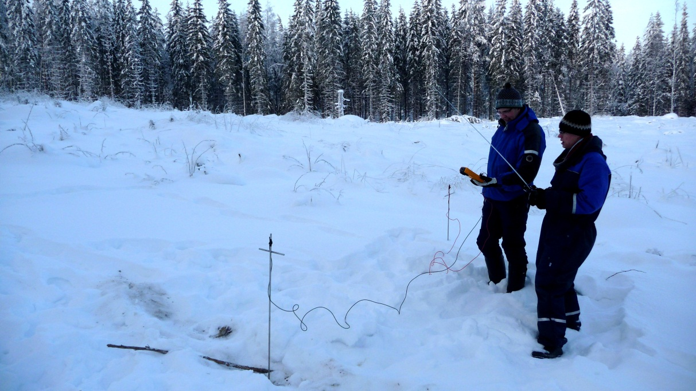
Location of sheath defect
Pertti Pakonen, Ossi Bergius / TUT, Department of Electrical Energy Engineering

Slide 24
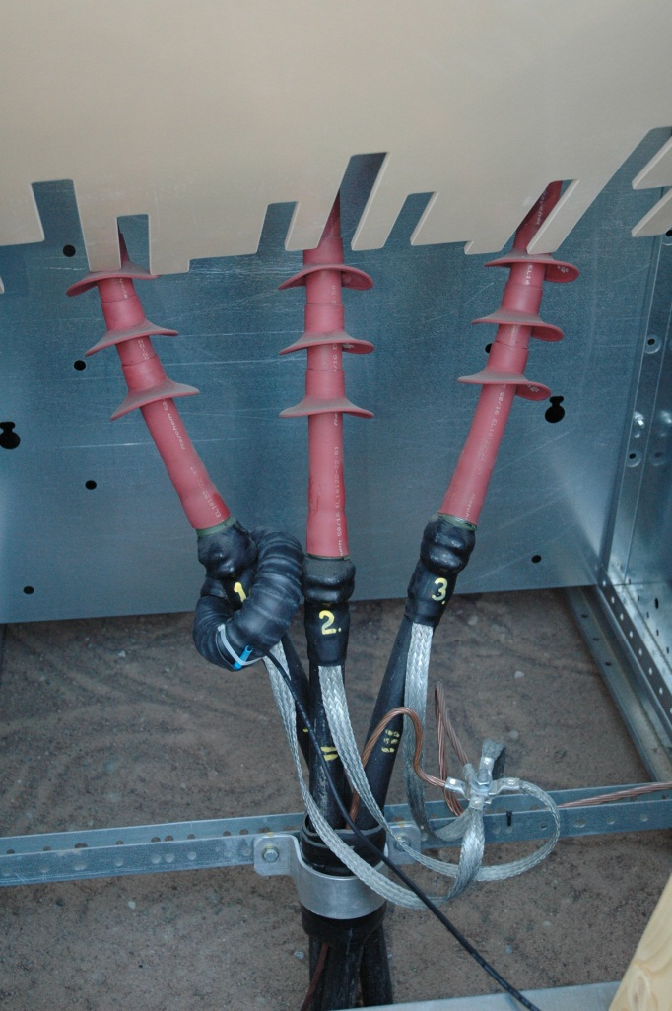
Example: On-line partial discharge measurement of heat shrink terminations in medium voltage cable network (1)
Example of the use of on-line partial discharge measurements:
Partial discharges have been spotted and failures have been occurred in heat shrink terminations of 20 kV cables due workmanship errors
  the stress relief at the end of insulation shield is improperly made or
  the heat shrink component is not heated enough so that the clue on the inner surface of the heat shrink component doesn’t attach properly from every spot to the surface of the stress relief layer and the cable insulation
  At the spot where the insulation shield ends partial discharges are ignited, which can be detected with partial discharge measurement or with thermal imaging
For instance with Rogowski-sensor the partial discharge measurement can be done without an interruption
The defect can also be detected with an off-line measurement
Rogowski-sensor
Pertti Pakonen, Ossi Bergius / TUT, Department of Electrical Energy Engineering
Notes:
The majority of the faults in underground cables takes place in cable joints or terminations. Nowadays heat shrink terminations, which are done at the installation site, are used in the medium voltage cables. If the heat shrink terminations are not made properly, interfacial cavities or locally too high electric fields might occur. The result of these are partial discharges and at the end dielectric breakdown.
Partial discharges can be detected with on-line or off-line partial discharge measurement or with thermal imaging.

Slide 25
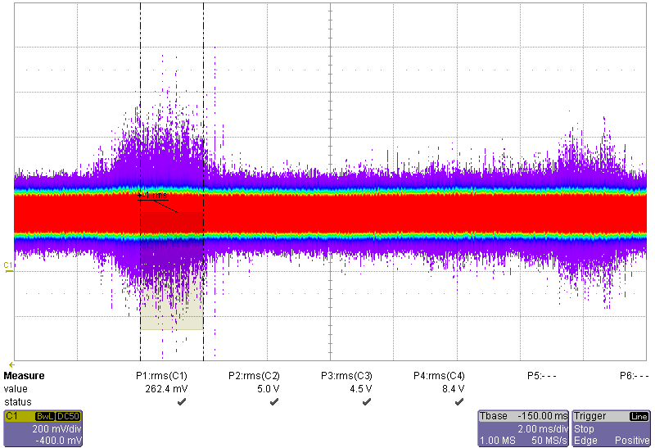
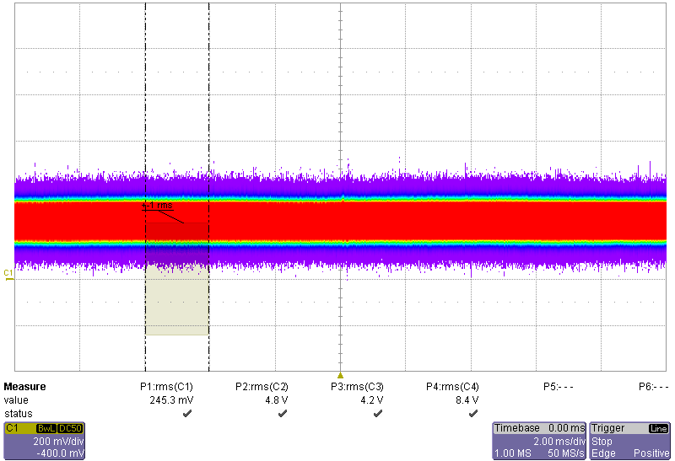
On-line partial discharge measurement of heat shrink terminations in medium voltage cable network (2)
Thermal image before the repair
PD-measurement before the repair
20 ms
Partial discharges
PD measurement after repair
(the termination is properly reheated)
Discharge location at the end of the insulation shield
(The rise of temperature about 1 degree).
Pertti Pakonen, Ossi Bergius / TUT, Department of Electrical Energy Engineering
Notes:
In the example case shown in the picture, the partial discharges in the heat shrink termination are caused by insufficient heating of the heat shrink component of the termination during its installation. The termination was fixed by reheating the heat shrink component so that the clue between the component and the main insulation attached properly from each spot. After the repair there were no partial discharge activity in the termination.

Slide 26
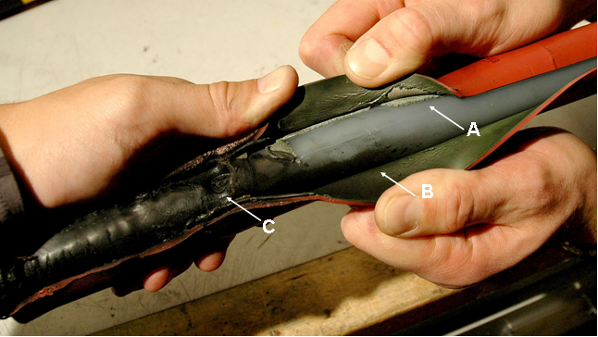
An example of an improperly assembled termination
The heat shrink part of the termination shown in the picture below hasn’t been heated enough from every spot and thus the shrink parts clue surface hasn’t attached properly to the surface of the main insulation at each point
Inside the born interfacial cavity partial discharges can take place and moisture can be accumulated
=> Risk of a dielectric breakdown (in this case the breakdown happened under 2 years after the installation of the termination)
A = The surface of the main insulation
B = The clue surface of the heat shrink
C = The stress relief at the end of the
insulation shield
Pertti Pakonen, Ossi Bergius / TUT, Department of Electrical Energy Engineering

Slide 27
Summary
Damage or workmanship errors during the transportation, storage or installation (damage caused during cable plowing, workmanship errors in cable joint and termination assembly, bad installation conditions) often lead to a failure of the cable after some time
The failure may happen after some months or years
With extensive enough commissioning measurements defected components could be detected and repaired already before the actual commissioning of the cable
  With sheath integrity measurements damages in cable sheath can be detected
  Cable joint and termination installation errors can be detected with partial discharge measurements
  Dielectric loss measurement reveals the moisture inside the main insulation
In urban areas construction work (buildings, roads and other infrastructure) might damage the structure or surface of a cable, the failure of the cable can happen only after years
  Condition monitoring during the whole life cycle of the cable
Pertti Pakonen, Ossi Bergius / TUT, Department of Electrical Energy Engineering

Slide 28
Challenges and development needs in quality assurance measurements
New challenges in MV underground cabling are caused by:
  ”New” installation techniques (e.g. cable plowing)
  New cable types and accessories
  The changes in operation models in network construction
    Cable excavation work or plowing is done by building contractor, which might not have any electro technical knowledge
    Longer contracting chains, more players (liability distribution, contracts, motivation, expertise, quality assurance)
    Cost and time schedule pressures created by competitive bidding
    The changes in work distribution e.g. in planning and material purchases
Development needs in quality assurance and commissioning measurements
  The definition of measurement methods
  The definition of limit values
  The development of electric documentation and documentation systems
  How makes the measurements?
Pertti Pakonen, Ossi Bergius / TUT, Department of Electrical Energy Engineering

Slide 29
When and what condition measurements should be done to cables and its accessories and by who?
At the factory after manufacturing? Today the manufacturer makes
  Elongation and Tensile Strength test – confirms that the extrusion has happened correctly
  Hot Creep and Hot Set test – confirms that material is cross-linked or cured properly
  Check of the dimensions (confirms that the diameters and insulation thicknesses are between the tolerances)
  High voltage test (withstand test 2,5 x U₀, 5 min), partial discharge measurement (reveals possible voids and contaminants inside the insulation – limit value 5 pC @ 2 x U₀)
  Spark testing (reveal punctures in outer sheath)
At the installation site before the installation?
At the installation site before commissioning? Today contractor makes
  Insulation resistance measurement (confirms that it is save to connect the voltage)
  Sheath integrity measurement (confirms that there are no punctures in the cable sheath)
Pertti Pakonen, Ossi Bergius / TUT, Department of Electrical Energy Engineering

