Slide 1
Actors in Demand Response and Their Roles
Petteri Baumgartner & Marko Seppänen
Tampere University of Technology
CITER / Department of Industrial Management
Contact: marko.seppanen@tut.fi; www.tut.fi/citer

Slide 2
Table of Contents
Introduction
Business ecosystem approach
Technologies
Demand response’s business ecosystems
Conclusions
The aim of this slideset is to demonstrate how business ecosystem approach can be used in identifying and crafting different business opportunities based on some Smart Grid technologies/solutions (AMR and HEMS).
Further information on SGEM research programme, http://www.cleen.fi/en/sgem
Notes:
This slideset is compiled from the Petteri Baumgartner’s MSc thesis that can be found from: http://urn.fi/URN:NBN:fi:tty-201401281062

Slide 3
Introduction
Notes:
Chapter 1 in the thesis.

Slide 4
What is demand response?
The U.S. Depart of Energy defines DR as:
Changes in electric usage by end-use customers from their normal consumption patterns in response to changes in the price of electricity over time, or to incentive payments designed to induce lower electricity use at times of high wholesale market prices or when system reliability is jeopardized. (2006, p. 6)
Notes:
U.S. Department of Energy. (2006). Benefits of Demand Response in Electricity Markets and Recommendations for Achieving Them. A Report to the United States Congress Pursuant to Section 1252 of the Energy Policy Act of 2005 . Washington, DC

Slide 5
What is demand response?
Demand response programs are administered by distribution system operators (DSOs), transmission system operators (TSOs), suppliers, or third-party aggregators that contract with DSOs, TSOs, or suppliers.
When an event occurs, customers are notified by a DR operator (one of the listed above) and typically respond by shedding load.
The DR operator, i.e., aggregator—the missing player?
Third-party aggregators enlist end users to participate in demand response curtailment and sell the combined load reduction to DSOs, TSOs, or suppliers.
Typically, the aggregator takes a percentage of the demand response incentive as compensation, passing the rest on to the consumer.

Slide 6
Business ecosystem approach

Slide 7
Definition of business ecosystem
In his book, Bionomics: Economy as Ecosystem, Michael Rothschild (1990) argues that key natural phenomena are central at business life, too.
According to James Moore, in business ecosystems:
Companies co-evolve capabilities around a new innovation: they work co-operatively and competitively to support new products, satisfy customer needs, and eventually incorporate the next round of innovations. (1993, p.76)
Notes:
Moore, J. F. (1993). Predators and prey: a new ecology of competition. Harvard Business Review, (May-June), 75–86.
Rothschild, M. L. (1990). Bionomics: Economy as Ecosystem. New York, NY: Henry Holt and Company.

Slide 8
Visualization of business ecosystem
Business ecosystem can be described as a network of actors that are bound together through collective operations to produce a holistic entity offering value for customers and satisfying their needs (Adner, 2006; Bahrami & Evans, 1995; Ginsberg et al., 2010; Iansiti & Levien, 2004a; Lusch, 2011; Moore, 1993; Teece, 2007).
Adner’s (2012, p.87) view on business ecosystem:
Notes:
Adner, R. (2006). Match your innovation strategy to your innovation ecosystem. Harvard Business Review, 84(4), 98–107. Harvard Business School Publication Corp.
Adner, R. (2012). The Wide Lens: A New Strategy for Innovation. New York, NY: Portfolio/Penguin.
Bahrami, H., & Evans, S. (1995). Flexible re-cycling and high-technology entrepreneurship. California Management Review, 37(3), 62–89.
Ginsberg, A., Horwitch, M., Mahapatra, S., & Singh, C. (2010). Ecosystem strategies for complex technological innovation: the case of smart grid development. In D. F. Kocaoglu, T. R. Anderson, T. U. Daim, A. Jetter, & C. M. Weber (Eds.), Technology Management for Global Economic Growth, Proceedings of PICMET ’10 (pp. 2787–2794). Phuket, Thailand: IEEE.
Iansiti, M., & Levien, R. (2004a). Strategy as ecology. Harvard Business Review, 82(3), 68–78.
Lusch, R. F. (2011). Reframing supply chain management: a service-dominant logic perspective. Journal of Supply Chain Management, 47(1), 14–18.
Moore, J. F. (1993). Predators and prey: a new ecology of competition. Harvard Business Review, (May-June), 75–86.
Teece, D. J. (2007). Explicating dynamics capabilities: the nature and microfoundations of (sustainable) enterprise performance. Strategic Management Journal, 28(13), 1319–1350.

Slide 9
Case example: Amazon versus Sony
In his seminal book, The Wide Lens: A New Strategy for Innovation, Adner (2012) presents a few case examples of innovation ecosystems; for instance, Sony versus Amazon in the race of e-book readers.
Adner (2012, pp.88–99) attests that Sony failed mainly for its inability to attract publishers with its PRS-500 e-book reader. Publishers, however, are fundamental element in the ecosystem since they provide the content.
With its Kindle, Amazon overcame the ecosystem problem by offering a closed platform, thus obviating the concerns about digital right management (DRM). The Kindle featured built-in Wi-Fi, too, enhancing the ease of use.
The next slide presents the corresponding ecosystems.
Notes:
Adner, R. (2012). The Wide Lens: A New Strategy for Innovation. New York, NY: Portfolio/Penguin.

Slide 10
E-book reader ecosystems

Slide 11
Case example: Friendster versus MySpace
Friendster is a social site that allows users share videos, photos, messages, and comments with other members via their profile.
Friendster was founded in 2002, beating MySpace by a year, let alone Facebook (founded in 2004).
However, the service could not hold the increasing number of users and it became impossibly slow once it got popular. In other words, some elements in the ecosystem could no hold the increasing number of users (Love & Lubin, 2011).
This steered the users to check out MySpace which managed to scale its ecosystem elements according to users.
Notes:
Love, D. & Lubin, G. (2011). 13 First-To-Market Products That Failed. Business Insider. Retrieved January 11, 2014 from http://www.businessinsider.com/first-to-market-products-that-failed-2011-5?op=1.

Slide 12
Case example: MySpace versus Facebook
Eventually, MySpace was run over by Facebook.
Facebook understood the importance of complementary services, i.e., complementors (Hartung, 2011).
It is the vast number of complementors that has been enabled Facebook to attract plethora of different types of users—there is something for (almost) everyone on Facebook.
In conclusion, the ecosystem shall converge multiple elements in order to thrive.
Notes:
Hartung, A. (2011). How Facebook Beat MySpace. Forbes. Retrieved January 11, 2014 from http://www.forbes.com/sites/adamhartung/2011/01/14/why-facebook-beat-myspace/

Slide 13
Technologies

Slide 14
Automatic meter reading
AMR enables collecting electricity consumption data in an hourly basis
Enables hourly-based energy tariffs, and helps all actors (DSO, supplier, consumer) to control the balance between supply and demand
The meters can be controlled remotely—means they can be switched on and off
EMV (2013) argues that switching on and off the meter is not DR but rather a standard network operation
Price-based DR program can be deployed via AMR but not direct load control.
Consumers have the responsibility to execute on-demand control commands to participate in DR
Notes:
EMV. (2013). Uudet palvelukonseptit ja regulaation rajapinnat (New service concepts and interfaces of the regulation). Dnro 592/421/2013. Energiamarkkinavirasto.

Slide 15
Automatic meter reading
DSOs have the responsibility of AMR implementation and measurement
Both DSOs and suppliers have access to the AMR data
The Finnish Energy Market Authority (EMV, 2013) stipulates that DR should be excluded from network operations,
Means that neither DSOs nor TSOs are ineligible to offer DR services
In Finland, the Section 5 of the Limited Liability Companies Act (624/2006) stipulates “the purpose of an incorporated (or limited) company is to generate profit to the shareholders”
System operators cannot make loss, although the loss could be compensated for by profiting from unbundled DR services
Notes:
EMV. (2013). Uudet palvelukonseptit ja regulaation rajapinnat (New service concepts and interfaces of the regulation). Dnro 592/421/2013. Energiamarkkinavirasto.

Slide 16
Home energy management system
HEMS features more functionalities than AMR-based system
HEMS enables integration with other home automation features
Third-party aggregators could offer turn-key aggregation, whereby a participant’s HEMS automatically initiates energy-saving measures at the onset of a demand response event
Using an existing HEMS connected via an internet gateway, a facility’s non-critical load is intelligently and automatically reduced by implementing predefined operational changes
Cycling equipment, turning off or dimming a portion of facility lighting and/or controlling the use of other energy-intensive processes

Slide 17
Home energy management system
Consumer’s comfort and convenience can be maintained by constant real-time monitoring
If maximum/minimum building temperature or minimum lighting levels are reached during the curtailment, the site automatically reverts to its normal operations
HEMS can be implemented independently uncoupled from AMR
No regulatory issues concerning operation responsibilities or liabilities
HEMS can be attached to AMR, too

Slide 18
Demand response’s business ecosystems

Slide 19
Consumer’s role
Consumers are the customers of suppliers and DSOs. However, the terms cannot be used interchangeably when speaking of demand response
For example, a third-party aggregator sells the load curtailment to suppliers, which makes the suppliers the customers
In the DR context, consumers rather make the DR service provider’s offer viable than act as the customers of it
Consequently, the emergence of DR renders the current view obsolete
DR services dislocate the ‘traditional’ structure of the electricity supply ecosystem (see the next slide)

Slide 20
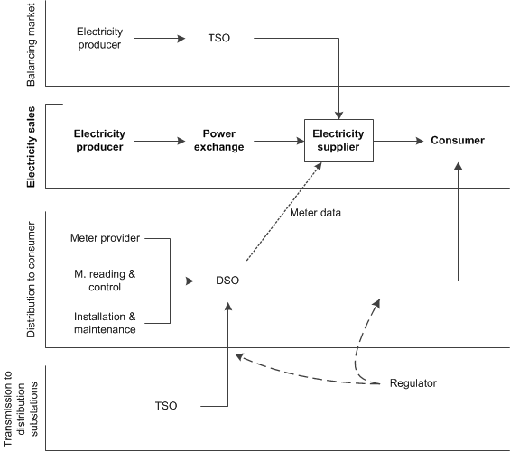
Electricity supply ecosystem

Slide 21
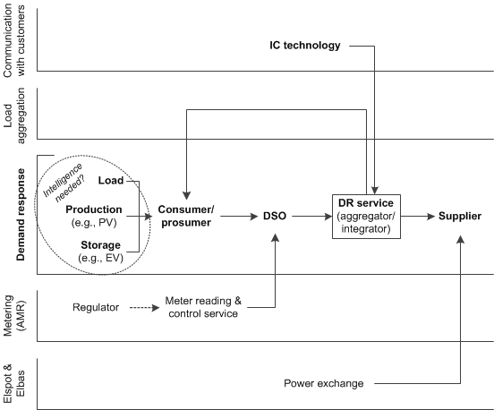
Demand response ecosystem (with AMR)
DR service operator enlists consumers/ prosumers to participate in DR program (i.e., the operator enables prosumers to sell ‘negawatts’ on the market)
Back coupling prosumer to the operator via DSO enables the operator’s use of AMR metering data.

Slide 22
Demand response ecosystem (with AMR)
Information and communication technology complements the DR service operator since communication between the prosumer and the operator is compulsory
The supplier is considered the end customer who purchases the DR service to control its balance settlement
Another perception of the value proposition is to substitute the power exchange for the supplier
Operator sells negawatts on the market as substitute for the back-up generation
Supplier could include DR in its offer taking care of the whole shebang by itself
AMR technology lacks the intelligence that automatically controls curtailment, thus making AMR-based solutions unfeasible to some prosumers

Slide 23
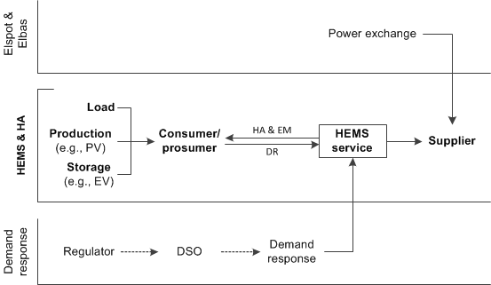
Demand response ecosystem (with HEMS)
HEMS provides the requisite intelligence to the premises
HEMS is independent of the DSOs, subtracting the DSO from the ecosystem is possible.
HEMS attached to other home automation features is considered since that can be seen to facilitate the adoption of DR, and future buildings can utilize home automation largely

Slide 24
Demand response ecosystem (with HEMS)
DR is actually complementing typical HEMS offering
HEMS service offers home automation (HA) and energy management (EM) to the prosumer
Offering is complemented with DR, implying that prosumer can benefit greatly from the service
Service can complemented with other features, as well (cf. Facebook ecosystem); e.g. automatic home surveillance
Economic logic could be the same as in AMR case: the sale of negawatts to the supplier or operating on the market
Third-party aggregators are more probable than all-inclusive suppliers due to the scale of business

Slide 25
Conclusions

Slide 26
Issues that are slowing DR business
In Finland, issues that generally impede the emergence of DR are unclear regulation concerning DR, function divided market for distribution and supply, consumer participation, and limited functionalities to a certain extent
Low prices of electricity and high quality of grid implicate no immediate need for demand response
Low prices implicate low savings from DR
System reliability is very seldom jeopardized
The major issue, regulation, needs political actions
Role of DSOs should be considered carefully
DSOs could probably benefit greatly from DR but they seems to be ineligible for those benefits

Slide 27
What could be done?
The regulatory model should be updated to meet the future needs of sustainable and secure electricity supply, including demand response
Power-based tariff structures would emphasize the reality and pave the way for demand response services
Power-based tariffs would require advanced metering infrastructure, more advanced than we have now
Companies should concentrate on scalable business ecosystems with their offers to ensure competitiveness in the future
Standardization of meters’ communication protocols could help in product development and harmonize the market
Poorly executed the standards may restrict the emergence of otherwise viable innovations

Slide 28
Further information, take contact
marko.seppanen@tut.fi +358 40 588 4080
SGEM research programme, see http://www.cleen.fi/en/sgem

