Slide 1
Developing Viable Ecosystems with Smart Grids
Petteri Baumgartner & Marko Seppänen
Tampere University of Technology
CITER / Department of Industrial Management
Contact: marko.seppanen@tut.fi; www.tut.fi/citer

Slide 2
Table of Contents
Introduction
Business ecosystem approach
Energy market and demand response
Issues slowing down the emergence of Demand Response
Conclusions
The aim of this slideset is to provide a theoretically grounded view on the development of ecosystems in the Smart Grid (SG) environment. Ways to solve perceived problems in SG are demonstrated through several case examples.
Further information on SGEM research programme, http://www.cleen.fi/en/sgem
Notes:
This slideset is compiled from the Petteri Baumgartner’s MSc thesis that can be found from: http://urn.fi/URN:NBN:fi:tty-201401281062

Slide 3
Introduction

Slide 4
Why to bother?
“One of the things to understand at the outset is simply, what does the value chain or ecosystem look like today? What are the different pieces?”
(Cusumano in Hopkins, 2011, p.60)
“At least for smart grids, employing an innovation ecosystem strategy appears quite important”
(Ginsberg et al., 2010, p.2792)
“Demand Response (DR) is one of several most important ingredients of the emerging smart grid paradigm”
(Li et al., 2012, p.1023)
Notes:
A couple of relevant quotes concerning the topic.

Slide 5
Energy market characteristics
“Current trends in energy supply and use are patently unsustainable—economically, environmentally, and socially” (Tanaka 2011)
To address the sustainability challenges, EU (2007) has set the energy and emission targets for 2020
“20-20-20” targets aim to reduction in greenhouse gas emissions, increasing the use of renewable energy resources, and improvement in energy efficiency
Demand response and energy efficiency have clearly been shown to be a potential approach to address the challenges concerning the electricity supply and consumption
Notes:
(Malik & Bouzguenda, 2011; Strbac, 2008; U.S. Department of Energy, 2006)

Slide 6
Business ecosystem approach

Slide 7
Roots of business ecosystem concept
Michael Rothschild (1990) argued that key natural phenomena are central at business life
According to James Moore (1993) in business ecosystems: “Companies co-evolve capabilities around a new innovation: they work co-operatively and competitively to support new products, satisfy customer needs, and eventually incorporate the next round of innovations”
The use of and research on ecosystem concepts have increased vastly in the current millennium
Notes:
Moore, J. F. (1993). Predators and prey: a new ecology of competition. Harvard Business Review, (May-June), 75–86.
Rothschild, M. L. (1990). Bionomics: Economy as Ecosystem. New York, NY: Henry Holt and Company.

Slide 8
Different types of ecosystem concept
Industrial ecosystem (Desrochers, 2002; Sharma & Henriques, 2005; Shrivastava, 1995)
Innovation ecosystem (Adner & Kapoor, 2010; Adner, 2006, 2012)
Product ecosystem (Frels, Shervani, & Srivastava, 2003)
Service ecosystem (Lusch, Vargo, & Tanniru, 2010; Lusch, 2011)
Technology ecosystem (Adomavicius, Bockstedt, Gupta, & Kauffman, 2007; Cusumano & Gawer, 2002; Gawer & Cusumano, 2008)
Notes:
Adner, R., & Kapoor, R. (2010). Value creation in innovation ecosystems: how the structure of technological interdependence affects firm performance in new technology generation. Strategic Management Journal, 31(3), 306–333.
Adner, R. (2006). Match your innovation strategy to your innovation ecosystem. Harvard Business Review, 84(4), 98–107. Harvard Business School Publication Corp.
Adner, R. (2012). The Wide Lens: A New Strategy for Innovation (p. 288). New York, NY: Portfolio/Penguin.
Adomavicius, G., Bockstedt, J. C., Gupta, A., & Kauffman, R. J. (2007). Technology roles and paths of influence in an ecosystem model of technology evolution. Information Technology and Management, 8(2), 185–202.
Cusumano, M. A., & Gawer, A. (2002). The elements of platform leadership. MIT Sloan Management Review, 43(3), 51–59.
Desrochers, P. (2002). Industrial ecology and the rediscovery of inter-firm recycling linkages: historical evidence and policy implications. Industrial and Corporate Change, 11(5), 1031–1057.
Frels, J. K., Shervani, T., & Srivastava, R. K. (2003). The integrated networks model: explaining resource allocations in network markets. Journal of Marketing, 67(1), 29–45.
Gawer, A., & Cusumano, M. A. (2008). How companies become platform leaders. MIT Sloan Management Review, 49(2), 28–35.
Lusch, R. F. (2011). Reframing supply chain management: a service-dominant logic perspective. Journal of Supply Chain Management, 47(1), 14–18.
Lusch, R. F., Vargo, S. L., & Tanniru, M. (2010). Service, value networks and learning. Journal of the Academy of Marketing Science, 38(1), 19–31.
Sharma, S., & Henriques, I. (2005). Stakeholder influences on sustainability practices in the Canadian forest products industry. Strategic Management Journal, 26(2), 159–180.

Slide 9
Ecosystem concept
Furthermore, one rationale around the ecosystem concept is that the “benefits…are real and well publicized” (Adner, 2006, pp. 99–100)
For example:
Platform leadership (Cusumano & Gawer, 2002; Gawer & Cusumano, 2008; Hopkins, 2011)
Keystone strategies (Iansiti & Levien, 2004a, 2004b)
Open innovation (Chesbrough & Appleyard, 2007; Chesbrough, 2003)
Value networks (Lusch, 2011; Vargo & Lusch, 2011)
Business ecosystem can be described as a network of actors that are bound together through collective operations to produce a holistic entity offering value for customers and satisfying their needs (Adner, 2006; Ginsberg et al., 2010; Iansiti & Levien, 2004a; Lusch, 2011; Moore, 1993; Teece, 2007).
Notes:
Adner, R. (2006). Match your innovation strategy to your innovation ecosystem. Harvard Business Review, 84(4), 98–107. Harvard Business School Publication Corp.
Chesbrough, H. W. (2003). Open Innovation: The New Imperative for Creating and Profiting from Technology . Boston, MA: Harvard Business School Press.
Chesbrough, H. W., & Appleyard, M. M. (2007). Open innovation and strategy. California Management Review, 50(1), 57–77.
Cusumano, M. A., & Gawer, A. (2002). The elements of platform leadership. MIT Sloan Management Review, 43(3), 51–59.
Gawer, A., & Cusumano, M. A. (2008). How companies become platform leaders. MIT Sloan Management Review, 49(2), 28–35.
Hopkins, M. S. (2011). Interview with Michael Cusumano. How to innovate when platforms won’t stop moving. MIT Sloan Management Review, 52(4), 55–60.
Iansiti, M., & Levien, R. (2004a). Strategy as ecology. Harvard Business Review, 82(3), 68–78.
Iansiti, M., & Levien, R. (2004b). The Keystone Advantage: What the New Dynamics of Business Ecosystems Mean for Strategy, Innovation, and Sustainability. Boston, MA: Harvard Business School Publishing.
Lusch, R. F. (2011). Reframing supply chain management: a service-dominant logic perspective. Journal of Supply Chain Management, 47(1), 14–18.
Vargo, S. L., & Lusch, R. F. (2011). It’s all B2B…and beyond: Toward a systems perspective of the market. Industrial Marketing Management, 40(2), 181–187. Elsevier Inc.
Ginsberg, A., Horwitch, M., Mahapatra, S., & Singh, C. (2010). Ecosystem strategies for complex technological innovation: the case of smart grid development. In D. F. Kocaoglu, T. R. Anderson, T. U. Daim, A. Jetter, & C. M. Weber (Eds.), Technology Management for Global Economic Growth, Proceedings of PICMET ’10 (pp. 2787–2794). Phuket, Thailand: IEEE.
Iansiti, M., & Levien, R. (2004a). Strategy as ecology. Harvard Business Review, 82(3), 68–78.
Lusch, R. F. (2011). Reframing supply chain management: a service-dominant logic perspective. Journal of Supply Chain Management, 47(1), 14–18.
Moore, J. F. (1993). Predators and prey: a new ecology of competition. Harvard Business Review, (May-June), 75–86.
Teece, D. J. (2007). Explicating dynamics capabilities: the nature and microfoundations of (sustainable) enterprise performance. Strategic Management Journal, 28(13), 1319–1350.

Slide 10
Visualization of business ecosystem
Adner’s value blueprint view on ecosystem (2012, p.87):
Notes:
Adner, R. (2012). The Wide Lens: A New Strategy for Innovation. New York, NY: Portfolio/Penguin.

Slide 11
Value Blueprint: Actors
The value blueprint map shows how intermediaries are linked to complementors and complementors to suppliers, how a firm is positioned in the ecosystem, and which actors are responsible for what
Actor | Definition and role
Supplier | Suppliers are actors who provide crucial input to focal firm. Focal firm needs supplier(s) in order to offer a complete product to end customer.
Focal firm | Focal firm is the most central company in the ecosystem.
Intermediary | Intermediary is actor that must adopt focal firm’s innovation before it reaches end customer.
Complementor | Complementor is an essential actor in the environment, outside of focal firm’s direct supply chain. End customer cannot utilize focal firm’s offer to its full potential without key complementor(s).
End customer | End customer is the final target of the value proposition of focal firm. End customer’s need to adopt the product for focal firm to claim success.
Adner and Kapoor (2010) and Adner (2012)
Notes:
Adner, R., & Kapoor, R. (2010). Value creation in innovation ecosystems: how the structure of technological interdependence affects firm performance in new technology generation. Strategic Management Journal, 31(3), 306–333.
Adner, R. (2012). The Wide Lens: A New Strategy for Innovation. New York, NY: Portfolio/Penguin.

Slide 12
Value Blueprint: Steps to Construct
Adner (2012, pp.85–87) provides an eight-step guide to construct a value blueprint
Initial steps
Identify end customer.
Identify your own offering (i.e., focal firm).
Identify your suppliers.
Identify intermediaries.
Identify complementors.
Additional steps
Identify the risks in the ecosystem.
Identify a viable solution for every partner unable or unwilling to cooperate.
Update the blueprint on regular basis.
Notes:
Adner, R. (2012). The Wide Lens: A New Strategy for Innovation. New York, NY: Portfolio/Penguin.

Slide 13
Value Blueprint: Reconfiguration
Five levers of ecosystem reconfiguration by Adner (2012, pp.177–178) explain how to modify the original ecosystem
Recolate
Separate/ Combine
Add/ Subtract
Bottleneck-free value blueprint
Notes:
Adner, R. (2012). The Wide Lens: A New Strategy for Innovation. New York, NY: Portfolio/Penguin.

Slide 14
Case example: Amazon versus Sony
In theThe Wide Lens: A New Strategy for Innovation, Adner (2012) presents a few examples of innovation ecosystems
Adner attests that Sony failed mainly for its inability to attract publishers with its PRS-500 e-book reader. Publishers are fundamental element in the ecosystem since they provide the content
With its Kindle, Amazon overcame the ecosystem problem by offering a closed platform, thus obviating the concerns about digital right management (DRM). The Kindle featured built-in Wi-Fi, too, enhancing the ease of use
The next slide presents the corresponding ecosystems
Notes:
Adner, R. (2012). The Wide Lens: A New Strategy for Innovation. New York, NY: Portfolio/Penguin.

Slide 15
E-book reader ecosystems

Slide 16
Case example: Valkee
Dedehayir & Seppänen (2013) have studied the disruption of the light therapy ecosystem
Seasonal affective disorder (SAD) has been combatted traditionally with light therapy, where intense light produced by a light box located in a room or in the office simulates the luminosity of sunlight
Exposure of 30 to 120 minutes per day to this intense light is required to receive sufficient treatment
Notes:
Dedehayir, O. & Seppänen, M. (2013). Business Ecosystem Reconfiguration through Disruptive Innovation. Conference paper, ICE 2013.

Slide 17
Case example: Valkee
Valkee Ltd.’s Bright Light Headset provides an alternative by channeling light through the ear canal onto the brain’s photosensitive regions
It is proposed that 6–12 minutes dose of the bright light per day is sufficient to attain the level of light exposure needed by an individual, Additionally, the unit is portable and less energy consuming

Slide 18
Case example: Aerial video production
Dedehayir & Seppänen (2013) present also another example: disruption of the aerial video production ecosystem
They demonstrate how radio controlled (RC) helicopter cameras have have a disruptive effect on the film industry
Aerial pictures and motion images have traditionally been provided by cranes mounted on trucks and helicopters
Such equipment is often rented by the film producer, and integrated with a camera team (including the camera crew and the camera equipment) for movie production
Combination of high quality Full HD cameras and RC helicopters to provide aerial photo and video services are to replace the helicopter or crane, resulting in greatly simpler aerial video production business ecosystem
Notes:
Dedehayir, O. & Seppänen, M. (2013). Business Ecosystem Reconfiguration through Disruptive Innovation. Conference paper, ICE 2013.

Slide 19
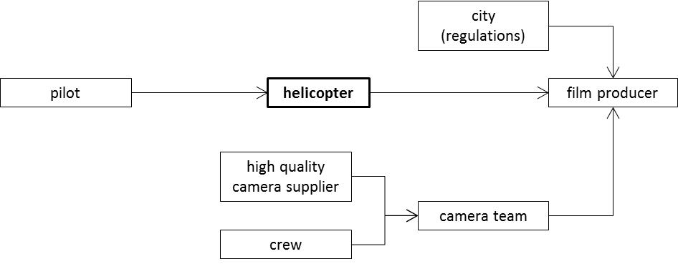
Case example: Aerial video production; The ecosystems of incumbent technologies
Notes:
Dedehayir, O. & Seppänen, M. (2013). Business Ecosystem Reconfiguration through Disruptive Innovation. Conference paper, ICE 2013.

Slide 20
Case example: Aerial video production, the new business ecosystem description
A significant reconfiguration is noted in the relocation of the camera from a complementor to a supplier position in the ecosystem.
Furthermore, the regulatory actor present in the incumbent helicopter ecosystem is subtracted completely.

Slide 21
Case example: Friendster versus MySpace
Friendster is a social site that allows users share videos, photos, messages, and comments with other members via their profile
Friendster was founded in 2002, beating MySpace by a year, let alone Facebook (founded in 2004)
However, the service could not hold the increasing number of users and it became impossibly slow once it got popular. In other words, some elements in the ecosystem could no hold the increasing number of users (Love & Lubin, 2011)
This steered the users to check out MySpace which managed to scale its ecosystem elements according to users
Notes:
Love, D. & Lubin, G. (2011). 13 First-To-Market Products That Failed. Business Insider. Retrieved January 11, 2014 from http://www.businessinsider.com/first-to-market-products-that-failed-2011-5?op=1.

Slide 22
Case example: MySpace versus Facebook
Eventually, MySpace was run over by Facebook
Facebook understood the importance of complementary services, i.e., complementors (Hartung, 2011)
It is the vast number of complementors that has been enabled Facebook to attract plethora of different types of users—there is something for (almost) everyone on Facebook
Notes:
Hartung, A. (2011). How Facebook Beat MySpace. Forbes. Retrieved January 11, 2014 from http://www.forbes.com/sites/adamhartung/2011/01/14/why-facebook-beat-myspace/

Slide 23
Energy market and demand response

Slide 24
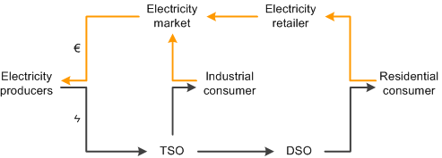
Electricity system
The electricity system is the twofold one of technical and economic subsystems
The technical subsystem represents the physical electricity flows (black line); the economic subsystem illustrates the money flows (yellow line)

Slide 25
The Nordic energy market
The Nordic countries have adopted free, shared electricity market with one common power exchange and nationally independent TSOs
The market comprises regulated and deregulated players
Regulated monopoly actors include transmission system operators (TSO) and distribution system operators (DSO)
Suppliers, producers, and other actors possible actors operate on market terms
Vertical integration of TSO, DSO, and market actors is prohibited
As a result, TSOs and DSOs are ineligible to bundle operations with market actors

Slide 26
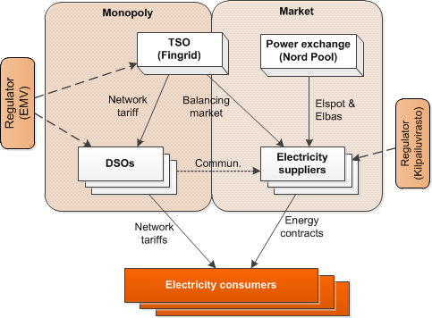
Finnish Electricity Market Structure and Actors
Electricity transmission and distribution operate on a natural monopoly basis, Energy Market Authority (EMV) regulates.
TSOs balancing market as well as power ex- change and reselling operate on market terms.
(modified from Sæle, Rosenberg, & Feilberg, 2010, p. 53)
Notes:
Sæle, H., Rosenberg, E., & Feilberg, N. (2010). State-of-the-art. Projects for estimating the electricity end-use demand. TR A6999. Trondheim.

Slide 27
What is demand response?
The U.S. Depart of Energy (2006, p. 6) defines DR as
Changes in electric usage by end-use customers from their normal consumption patterns in response to changes in the price of electricity over time, or to incentive payments designed to induce lower electricity use at times of high wholesale market prices or when system reliability is jeopardized.
Notes:
U.S. Department of Energy. (2006). Benefits of Demand Response in Electricity Markets and Recommendations for Achieving Them. A Report to the United States Congress Pursuant to Section 1252 of the Energy Policy Act of 2005 . Washington, DC

Slide 28
What is demand response?
Demand response programs are administered by distribution system operators (DSOs), transmission system operators (TSOs), suppliers, or third-party aggregators that contract with DSOs, TSOs, or suppliers
When an event occurs, customers are notified by a DR operator and typically respond by shedding load
The DR operator, i.e., aggregator—the missing player?
Third-party aggregators enlist end users to participate in demand response curtailment and sell the combined load reduction to DSOs, TSOs, or suppliers
Aggregator takes typically a percentage of the demand response incentive as compensation, passing the rest on to the consumer

Slide 29
Issues slowing down the emergence of Demand response

Slide 30
Issues hindering demand response
In Finland, issues that generally impede the emergence of DR are unclear regulation concerning DR, function divided market for distribution and supply, consumer participation, and limited functionalities to a certain extent
Low prices of electricity and of high quality grid implicate no immediate need for demand response as yet
Low prices implicate low savings from DR.
System reliability is very seldom jeopardized.
The major issue, regulation, needs political actions
Role of DSOs should be considered
DSOs would benefit greatly from DR but they seem to be ineligible for those benefits

Slide 31
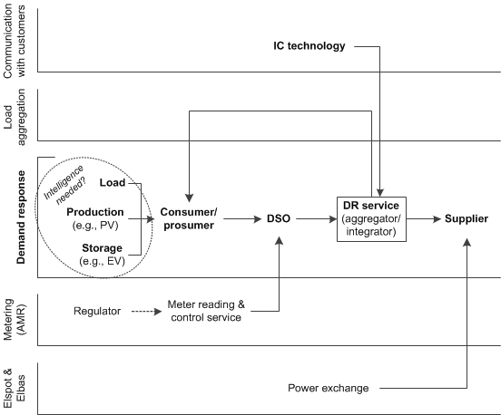
Potential DR ecosystems (1/3)

Slide 32
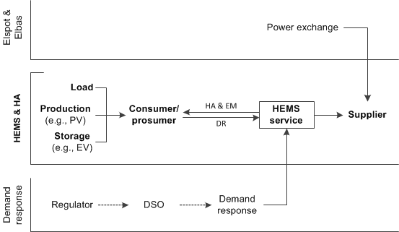
Potential DR ecosystems (2/3)

Slide 33
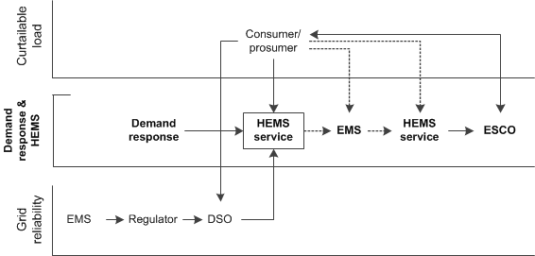
Potential DR ecosystems (3/3)

Slide 34
Conclusions

Slide 35
What could facilitate the business?
Wannabes (a firm willing to replace the current leader) could speed up the business
It might be hard for a single firm to promote and develop its product or service alone but it needs support from competitors
Competition not only makes companies vulnerable to underachieve compared to their rivals, but it also promotes the success of an innovation in its early stages (catalyzing change)
More startup companies could accelerate the emergence of viable businesses
What are the needed actors?
Do the Nordic electricity markets need aggregator firm to take care of DR, or could DR be part of suppliers’ or DSOs’ activities?
Notes:
Cusumano, M. A., & Gawer, A. (2002). The elements of platform leadership. MIT Sloan Management Review, 43(3), 51–59.
Fine, C. H. (1998). Clockspeed: Winning Industry in the Age of Temporary Advantage. New York, NY: Perseus Books.

Slide 36
Further information, take contact
marko.seppanen@tut.fi +358 40 588 4080
SGEM research programme, see http://www.cleen.fi/en/sgem

